Slide 1

Asphalt Alert: A Pothole Management System
KM Kiyo
221049296
Mini Project

Slide 2
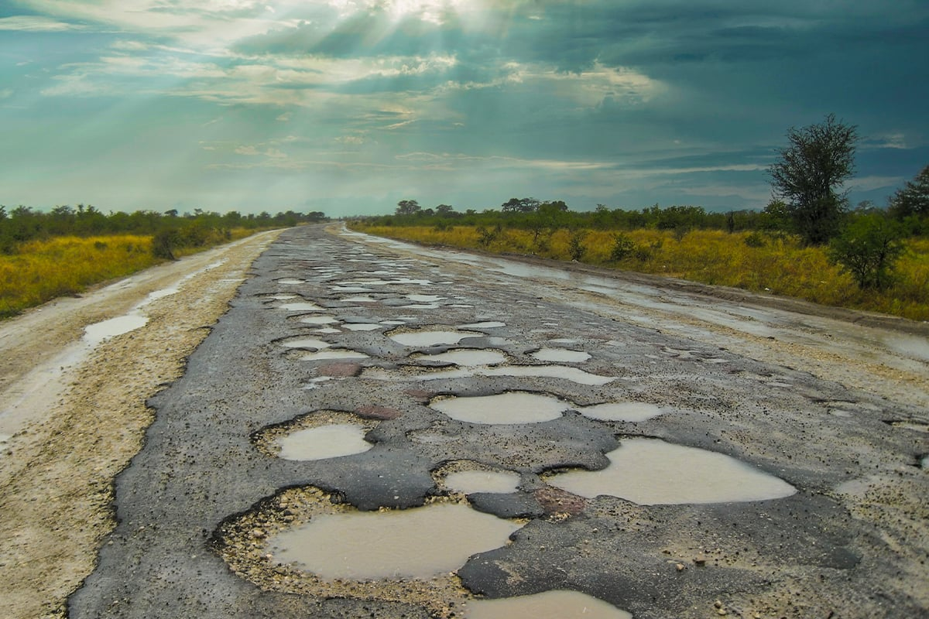
Problem Statement:
In South Africa, potholes are a major crisis that can exacerbate other socio-economic ills such as crime.
This leads to the further deterioration of South Africa’s road network and this is hazardous to freight, and drivers that make use of the roads.
Notes:
Potholes are a major crisis in South Africa. The impact of potholes is not just limited to increased maintenance costs for vehicles along with safety hazards but can also exacerbate other socio-economic issues, such as crime. For example, to prevent wear and tear on their vehicles, drivers will drive slower and unfortunately some of them fall victim to hijackers. In addition, the deterioration of South Africa's road network is hazardous for freight and drivers, making it a pressing issue that needs to be addressed.

Slide 3
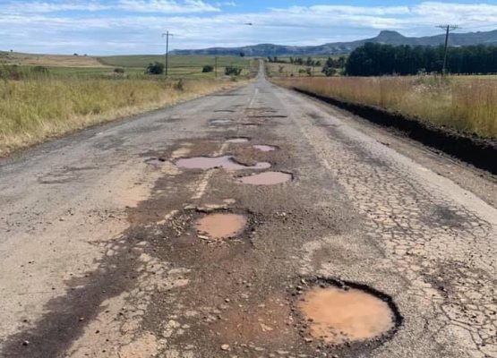
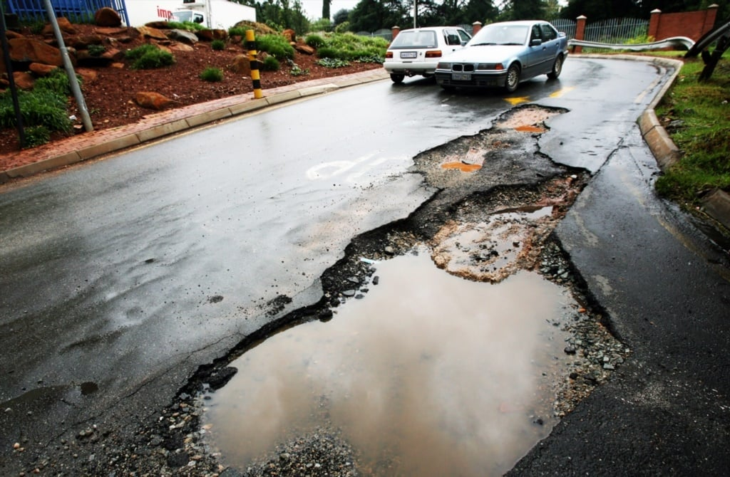
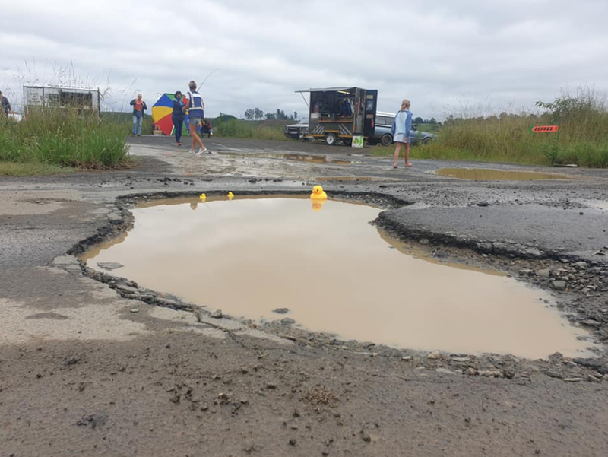
Pothole classification system:
There are three main classes of potholes according to SANRAL:
Class 1: <25mm Depth & <100mm Diameter
Class 2: 25mm – 50mm Depth & 100mm – 300mm Diameter Class 3: >50mm Depth & 300mm> Diameter
Notes:
To better understand the severity of the issue, the South African National Roads Agency Limited (SANRAL) has categorized potholes into three main classes based on their depth and diameter. Class 1 potholes have a depth of less than 25mm and a diameter of less than 100mm. Only causing minor discomfort for drivers. Class 2 potholes range from 25mm to 50mm in depth and 100mm to 300mm in diameter. Finally, Class 3 potholes have a depth greater than 50mm and a diameter larger than 300mm. Class 2 and Class 3 potholes cause more damage to vehicles and can even be life-threatening. By categorizing potholes in this way, we can prioritize repairs and allocate resources more effectively.

Slide 4
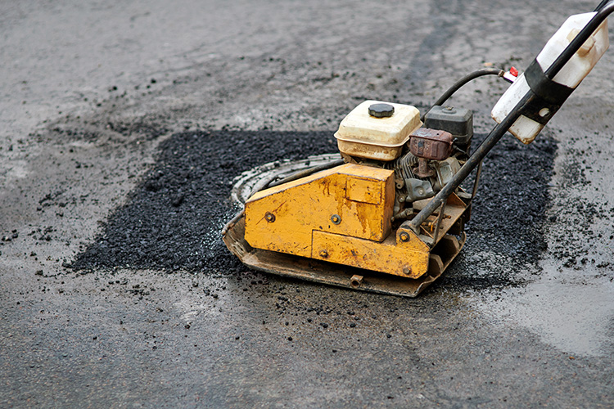
Solution:
The solution is a system that allows for the easy logging and tracking of potholes. The system should provide insights into how potholes can be fixed efficiently.
This will help SANRAL and other authorities to:
improve resource-allocation and usage
mitigate other socio-economic ills
Notes:
The solution is a system that allows for the easy logging and tracking of potholes by making use of graphs. The system should provide important metrics, such as the severity of potholes, their distribution, and their impact on our road networks. We can then use algorithms on our data to determine how to best allocate resources, improve response time when fixing potholes and over time use the historical data about pothole repairs to enable better decision-making for future maintenance plans.

Slide 5
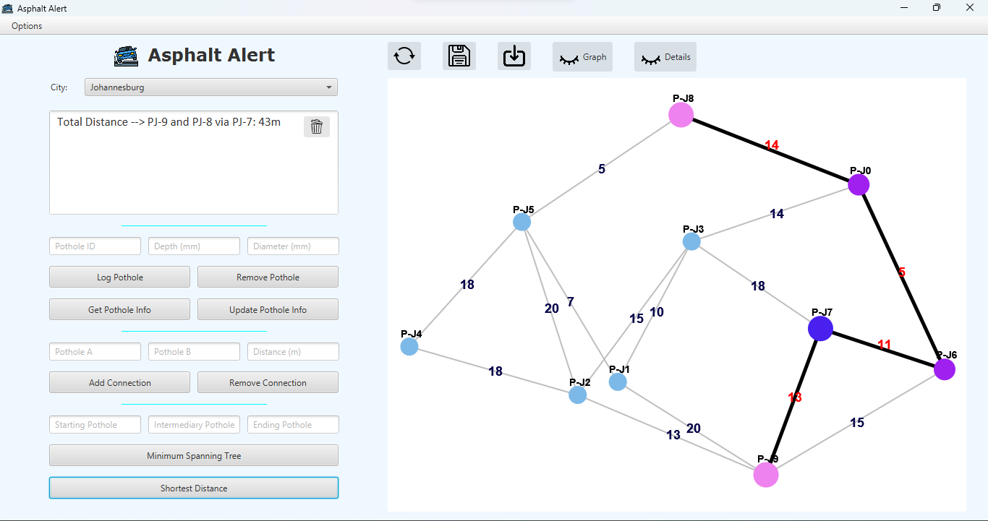
Asphalt alert IN ACTion:
Notes:
This is what Asphalt Alert looks like in action!

